Slide 1
Data, Version Control, and JavaScript

Slide 2
Data Biography or Archaeology
Important concept in digital cultural heritage + pitching projects
Get to know your data before you use it!
Ask questions of it
Create background and origin + metadata
Just like you would check on a human source of information always check your data.
Don’t take your data at face-value; assuming the first glance story is true is naive. This is also important for version control

Slide 3
Ask Questions!
Where did it come from?
Who collected it?
How was it collected?
Most importantly, why was it collected?
Data isn’t just about numbers but how those numbers got there in the first place…
Data is not objective nor is it neutral

Slide 4

Version Control
Notes:
Version control is essential. This is really helpful if something goes really wrong. The absolute minimum for this is a coherent file naming system and a plan for how to restore things if it goes to shit.
Version files with numbers not things like “final-final” but if you use numbers be sure to use a zero before single digits or version 10 will appear above version 2. This might need to change if you have over a hundred versions.
Make back-ups of everything you don’t want to lose - you can do this with local quick and incremental back-ups or after you finish working. But plan for the catastrophe as well - email yourself a copy, have an external harddrive. The gold standard however is working within a version control system.
A version control system is generally deployed in collaborative environments like for example - google docs or one drive docs. It is a system that records and changes to a file or set of files over time so that you can recall specific versions later
Important because
Keeps tracks of changes and allows you to rollback to previous versions if you screw up
For collaborative work: managing and distributing work so changes aren’t overwritten or deleted accidentally
There are three types of version control systems:
Local - When working with a local version control system, you’re working with one local computer. If you’ve ever made multiple copies of the same word document to keep track of your changes (“rough draft”, “rough draft 2”, “final draft”) then you have done this. But this approach is incredibly error prone since it’s easy to forget which directory you’re in and accidentally write to the wrong file or copy over files you don’t mean to.
Centralized - A centralized system works on a Client-Server relationship. The repository is located in one server which provides its clients (local computers) access to the stored versions of its codebase. When working on the code from this server, any new changes to the code are tracked by this version control system.
New version of the application are created by selecting all the versions of these changes to the code that you want.
There are a couple of catches though:
First, everything is accessed from the central server. In order to do this you have to be online.
Second, there is only a single master copy of the codebase.
This gives an administrator more control over their code, but it often means that only one person can work on code at a time.
Any piece of code that is being worked on is typically locked, or “checked out” so that only one developer is allowed to work on that code at any time.
That’s because any differences in the codebase for the same version being worked on would create a conflict which must be resolved.
Distributed - Distributed Version Control Systems, mirror the complete codebase, including its full history of changes, onto every developer’s computer. This has several advantages, but one of the main advantages is how you don’t have to rely on a single location for backups.
The server and each computer with the repository will have the latest version and the changes that led to it.
This also allows you to work offline, since the entire codebase is on your computer.
Changes made to the codebase are also handled differently by the distributed system.
When somebody makes a change to the code, they submit those changes to the owner of the code who can either approve or disapprove those changes. The latest version of the application then becomes the most recently accepted changes.
Developers may also work on the same sections of code at the same time since they are not drawing from a single master codebase.
You can create forks and branches from the original repository which can then be merged back into the original code.
So what do all these differences really mean?
Let’s say Rena and I both want to work on the same coding project.
In a local system - we would not be able to communicate at all from our separate computers. I’d have to work on a versions of my files and send them to her through email or something else to Ashley where she could then work on her own version and send it back. Or we could work from the same computer. Either way, not very efficient.
In a centralized system – there would be a central server with our codebase. We would have to connect to that server every time I’d want to make changes to it, and we would not be able to work on the same pieces of code at the same time. The different code versions we have worked on would then need to be deliberated through to decide which versions will go into the final application.
In a distributed system – Ashley and I would each download the codebase and make changes to it on our local computer. Any changes we make would then be submitted to the codebase, which are then reflected in every instance of the codebase. We can also work on the same bit of code, choosing which every code works best, or the best parts of each code.
The distributed system gives us a lot of flexibility. Git is one version of this type of system.

Slide 5
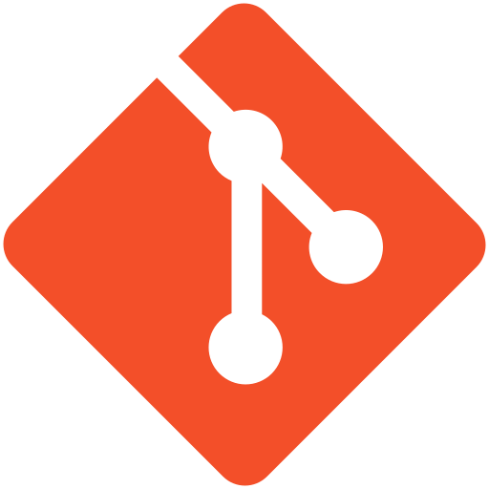
Git
Distributed VCS
Tracks Changes
Collaborative
Popular
87% of Stack Overflow Users
Underlying Basis for GitHub
Notes:
Git is a distributed version control system with all of the advantages of that system:
Two important ones of which are the ability to tracks changes and the ability to have multiple people to work on the same project.
It has become an extremely popular system amongst developers. Stack overflow is a popular forum for programmers to ask questions, and they found in a 2018 Poll that 87% of their users were using git.
So how do you use this popular platform?

Slide 6


GitHub
What Is GitHub?
git – Version Control
Hosting
Software Development
But Wait, There’s More!
Community
Professional Capital
Openness
Notes:
At its core GitHub is a cloud based platform where you can store, share, and work together with others to write code.
Storing your code in a "repository" on GitHub allows you to:
Showcase or share your work.
Track and manage changes to your code over time.
Let others review your code, and make suggestions to improve it.
Collaborate on a shared project, without worrying that your changes will impact the work of your collaborators before you're ready to integrate them.
Collaborative working is one of GitHub’s fundamental features.
There are some important aspects of GitHub:
GitHub uses git.
as I mentioned before, git is a programming language/system that can be used to keep track of a project across multiple computers as you make changes to it. When I say things like push, pull, fork, fetch, or commit, that is the git system performing tasks. And these tasks allow your computers and the GitHub.com servers to keep track of every single change you make to your project. So, if you want to go back 30 commits and see what the project looked like 30 commits ago, git makes it easy to do that on your computer or on the github.com server. You all will be able to look through the entire history of your project.
Git as a language can be used by itself by anyone using a server and local computers. Platforms like GitHub.com just uses git as the base for a number of benefits that it provides.
GitHub provides us with free web hosting.
GitHub offers a service they call GitHub Pages. By making your repository available to GitHub Pages, GitHub.com will display your code repository on a website that anyone can view.
It a powerhouse when it comes to software development.
GitHub allows you to pull files onto your computer where you can then work on them and make changes without an internet connection. You can then merge those changes back into the online files while logging all the changes that you’ve made. It’s an amazing tool for project management.
GitHub is also a social platform with a large community.
A lot of people use GitHub, and the way its organized encourages you engage with other developers.
It’s sort of like social media for coding. You’re able to leave comments on your code and other people's code,
and you can even make your own changes to their code and see if they’ll accept those changes.
You start of super detailed, then as the project goes on, sometimes you feel like being not so detailed and just getting the work done. Many times though I have gone back to work on something and which I had explained my logic for doing things.
But, moving on. Since GitHub is such a large community, there is also some professional weight to using it.
GitHub is a serious tool for developing things and just knowing how to use it shows that you have experience coordinating productively with others on a project. Everyone’s GitHub profile is public. You all could go to my profile and see all the public coding I’ve been working on.
Which brings me to the last point I’d like to make, which is that GitHub is that it’s innately open.
Coding on GitHub allows others to view and use your code for their own purposes, while also keeping the history of who originally wrote that code. I am a big believer in open source, and GitHub.com is a great facilitator of providing open source software.

Slide 7
Important Terms
Repository: The project
Branch: An independent line of development in a repo
Fork: Distinct copy of a repository
Clone: Copying all files from a repository to your local machine
Fetch: Look for differences between the GitHub.com and local repository
Pull: Pulling differences from a GitHub repo onto a local repo
Commit: Prepares the latest changes of the local repo to be submitted to the GitHub repository. Requires a descriptive message.
Push: Pushing your changes onto the GitHub.com Repository.
Pull Request: A request by to merge the code from two repositories.
Notes:
GitHub terms (are also general git terms, shared among the similar software)
Repository: the project; collection of files that comprise the project; resides in a central (and accessible) location (the repository sits on the server)
Branch: A branch is an independent line of development in a repository (such as a source code file or a document) so that modifications can happen in parallel along both branches and doesn’t affect other branches; in GitHub, the main default branch is called main which is shown to visitors and used as the basis for pull requests or cloning.
Forking: when developers take a copy of source code from one software package and start independent development on it, creating a distinct piece of software; copying a repository and will make it show up in your account (branching will not); taking a carbon copy and moving it entirely under your control and away from the control of the original owner (still retains connective tissue, not deleting the repository’s DNA)
Fetch: allows you to pull any changes that have been made to the original repo into your local version
Cloning: copying all of the files from a repository to your local machine (for editing, etc.) 🡪 downloading files to your machine and use GitHub desktop to work on the files
Committing: submitting the latest changes of the source code to the repository, and making these changes part of the repository (any branch); push all local changes to the main repository 🡪 can then commit the changes 🡪 commit changes to the local repository before pushing to the main and committing again
Pull request: a request by the person who forked the repository to roll any changes they made back into the main (original) repository; asking for permission to commit changes and describing what you have done (can’t do a pull request without a commit message and can’t commit without a description); can set it up so that collaborators do not need to submit pull requests and automatically commit changes

Slide 8
Using GitHub
For coding:
Make sure you’re working in GitHub Desktop
Use VSC for edits and changes
Don’t code on web version
Web is for Repository management
When coding collaboratively you do things like:
create/close repository
Work in github and vsc on your desktop
Add collaborators to a project
Clone projects
Notes:
VSC- Visual Studio Code

Slide 9
Best Practices
Always
Write a good commit message
Commit when you stop working
Fetch origin when you start working
Work locally
Never: edit on the web in collaborative projects
Conflicts occur when people are working on the same thing - these can be fixed but generally best to avoid.

Slide 10
GitHub Workflows
In a Git-based workflow, you would:
Create a branch off from the main copy of files that you (and your collaborators) are working on.
Make edits to the files independently and safely on your own personal branch.
Let Git merge your specific changes back into the main copy of files, so that your changes don't impact other people's updates.
Let Git keep track of your and other people's changes, so you all stay working on the most up-to-date version of the project.

Slide 11


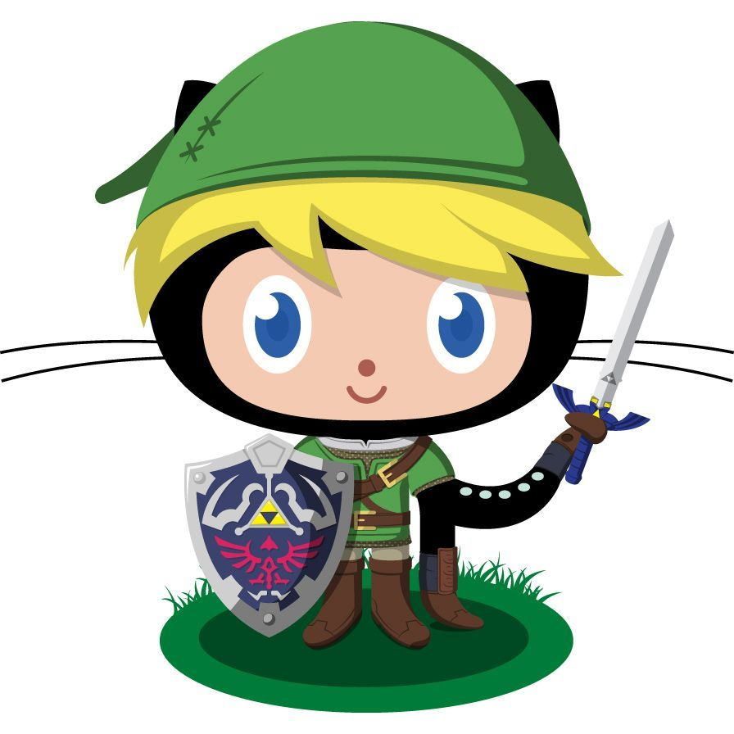

Workflow Diagram
5. Stage Changes
9. Pull Request
7. Push
6.Commit
1. Fork
2. Clone
4. Save
Indian Country
New Repository
Local Repo A
Changed Local A
2. Clone
3. Change
8. Pull Request
4. Save
GitHub.com
GitHub Desktop
Visual Studio
7. Push
Local Repo B
Changed Local B
6. Commit
5. Stage Changes
Notes:
This is an example of a cloned repo workflow in pairs. You’ll notice the first action is forking to create a new repo which is then cloned for working locally in “A” and “B” locations (i.e. the partners). Both A and B will make changes to the workflow locally, save those changes, commit those changes and then push them back to the new repository. On the far left at the main or original repo you’ll see push and pull requests as well. You’ll want to pull any changes to your fork whenever you start working so you have the latest version, and you’ll want to push when you make changes locally to a fork and have finished for the day.

Slide 12
GitHub and GitHub Pages
GitHub can serve as web-hosting platform:
Free to use
It’s available in public repositories
Static site hosting service that takes HTML, CSS, and JavaScript files straight from a repository on GitHub
It will not host php or dynamic sites (at least not well)
The site is linked to your username
Notes:
PHP - scripting language (mostly used for backend service-side web development)
Dynamic sites - build pages based on who you are and what your doing (e.g., history, content, profile, etc.)
Can contrast with static site is what it sounds like, basically the same for everyone. You build it and put it out there

Slide 13
Web Building Languages
Three pillars of front-end web building:
CSS (Cascading Style Sheets) - this is design
HTML (Hyper Text Markup Language) - this is structure
Javascript - this is interactivity
Back-end web languages:
PHP + SQL are databases
Python
Node.js
Ruby
Notes:
In CHI we are more concerned with front-end building for on the web. We will primarily use CSS, HTML, and Javascript.

Slide 14
Javascript
Javascript is a scripting language <script>
Not compiled
Accessible and light weight
Client-side execution
PHP is server-execution
Your browser runs the javascript generally enabled on all browsers - you can toggle on/off - https://www.enable-javascript.com/
Web runs PHP
Notes:
Javascript not to be confused with Java is a non-compiled scripting language. 99% of websites on the web use javascript in some shape or form. It is non-compiled which means source code is translated and executed line by line by an interpreter whereas compiled languages translate source code into machine code before execution with a compiler. So line by line vs all at once.
Because it is not compiled it is easy to write (accessible) and execute. It is supported by all modern browsers and is lightweight, responsive and very quick for a non-compiled language. The more code you have the more processing power it takes and that’s why web developers use compiled languages. JavaScript can now also function as a JIT (just-in-time) compilation language which means that compilations of source code are done at run-time (execution) rather than line by line which saves on time. A system implementing JIT typically continuously analyses the code being executed and identifies parts of the code where the speedup gained from compilation or re-compilation would outweigh the overhead of compiling that code.
Javascript is used primarily for web design and interactivity. It works for customizing user experiences and integrates directly into HTML.

Slide 15
Javascript
Javascript is the only programming language that runs natively on the web
Its start was interactivity (1995)
Now it's everywhere
It is an event driven language - “when user clicks here do this”
Forgiving but surprising
It’s also asynchronous and waits for instruction

Slide 16
Javascript
Javascript functions with HTML in a few ways:
You can integrate it directly into the file
<script></script>
You can load it into the header, footer, or body
<head> <body>
<script></script> <script></script>
</head> </body>
Create a separate external script file - script.js
Example: myFunction() {everything in here is JS}
Notes:
What can you do with JS
Create highly responsive user interfaces and experiences
Load content without reloading the browser
Perform calculations and automate routine tasks
The only real limitation here is the browser because it is the tool that runs the script instead of a server

Slide 17
Javascript Libraries
Prewritten libraries
Allows for quicker development
Vanilla vs Libraries = from scratch vs. borrowing
Created by a human - so there will be limitations
Sits on their server
Always up-to-date
Maintained elsewhere
You still need to understand Javascript to use Javascript libraries of code

Slide 18
Javascript Libraries
Javascript libraries are primarily used for data visuals + user experience:
Leaflet JS is a mapping library
jQuery.js used primarily for effects + animations
D3.js generally used for dynamic data visualization
chart.js for charts and graphics (easiest to learn)
Popper.js mostly used for popups and layovers
Hammer.js adds touch features (mobile apps/touchscreens)
Bespoke.js turns html into slide decks

Slide 19
Javascript Libraries
How do they work?
Externally +
In the <body></body> +
In the <head></head>
Code is called externally, then you call file in head + call function in body
Why not use them?
You give up some flexibility
Hard + complicated
NCBM (Not coded by me)

Slide 20
Javascript Libraries
Ways to succeed:
Thoroughly read the documentation: hit-or-miss depending on the quality of the documentation (made by humans, subject to variations)
Leaflet has excellent documentation
Look for (and do) relevant tutorials
Use community to your advantage
Get on stack overflow or reddit and ask

Slide 21
Javascript Frameworks
Frameworks are building applications
Frameworks allow developer manipulation
Think of frameworks like building materials - readymade material
Construction = faster + saves money and time
Code is again prewritten
Mostly used for front-end development
Examples:
Bootstrap
Jekyll
Gatsby
Foundation
Notes:
Front-end frameworks
Like Bootstrap, Foundation, etc. (Jekyll fits here too)
Can get painted into a corner because you didn’t code everything yourself
Changing a little thing can have unintended consequences (version control suuuuuper important here)
Templates are built by humans, so each template is different (changes in organization and decisions)
Need to make compromises
Be careful about your choices here

Slide 22
Javascript Frameworks
Frameworks are different from libraries
Libraries are power tools
Frameworks are components and blueprints
They all share the same concepts:
Components - reusable building blocks
Management - tracked data as it changes
Routing - multi-page application
Reactivity - UI automatically updates
Notes:
How JavaScript Libraries and Frameworks Work Together:
The difference between JavaScript libraries and frameworks lies in its flow of controls. They are just opposite in the flow, or inverted
In JS libraries, the parent code calls the function that a library offers
In JS frameworks, the framework itself calls the code and defines the overall application design.
Simply put, you can think of JavaScript libraries as a function. In contrast, the framework acts like its skeleton, while an API acts as the connector to bring them together.
The ecosystem is basically Javascript (language) → Libraries (tools) → Frameworks (structure)

Slide 23
JavaScript is messy and that’s ok. Break stuff and have fun. Trial and error is what it’s all about. JavaScript is the paintbrush for the web.

Slide 24
Rapid Development Pitch Websites
The website should contain a landing page and several sub pages.
Each sub page should correspond to one of the sections in the vision document
Think about Data, Deliverables, etc
You should also have a sub page for “the team” with a pic and a bio for each of the team members.
Have all of these files on a GitHub repository.
Publish the files to the web using GitHub Pages.
Use a front end framework (Bootstrap, Foundation) to create the site.
You are welcome to use a template for your front-end framework.
Here is a cheat sheet for Bootstrap and a guide to Foundation.
Add additional content beyond the original vision document as you see fit.

